Slide 1
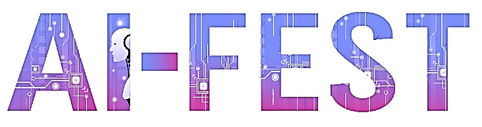

SIGN LANGUAGE TRANSLATOR
AI-FEST
Project Evaluation
Name: Ali ziyan (GL)
Name: Riaan Sadiq
Name: Ayaan Sadiq
Name: Razeen Hassan
Instructor: Sir. Zahid
Industry Partner: Rabil Maknojia
Department of Computer Science - DHA Suffa University

Slide 2


Summary
Project Brief Introduction
Problem Statement
Dataset Description
Project Scope
ML/DL/NLP Model Details
Results and Discussions
Tools and Technologies Learnt During the Project Implementation (Individual Skills Set)
Project Demo
References (last accessed)

Slide 3
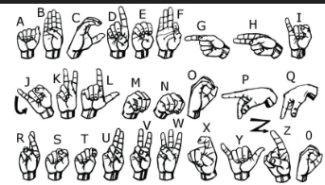
Project Brief Introduction
The Sign Language Machine Learning Project aims to leverage the power of artificial intelligence and machine learning to develop a robust system for recognizing and translating sign language gestures into written language. This project is designed to bridge the communication gap between the hearing-impaired community and the general population, fostering inclusivity and accessibility.

Slide 4
Problem Statement
The primary problem is the communication barrier between the deaf and hard of hearing individuals and the broader society in Pakistan. Deaf students often struggle to receive quality education due to a lack of trained teachers and insufficient educational materials.

Slide 5
Dataset Description
We have created our own dataset for a sign language project, consisting solely of 50x50 grayscale images representing all the alphabets. This dataset includes 1000 hand gesture images for each of the 26 alphabetic signs, ensuring a comprehensive collection. The dataset is meticulously organized and annotated, making it highly useful for various applications. By focusing on grayscale images, we aim to streamline the processing and analysis stages, providing a robust foundation for research, education, accessibility, and technology development in the realm of sign language.

Slide 6
Project Scope
This project focuses on detecting American Sign Language (ASL) alphabet gestures using a Convolutional Neural Network (CNN) and displaying the corresponding letter being signed. The system employs a CNN model to analyze hand shapes captured in images, enabling it to accurately recognize and interpret various ASL alphabet gestures in real-time.
Data collection
CNN model training
Deployment using flask

Slide 7
Model Details
We have use “CNN Model”. A Convolutional Neural Network (CNN) is a type of deep learning algorithm that is particularly effective for image recognition and classification tasks. In the context of sign language recognition, CNNs can be used to analyze hand shapes captured in images and translate them into corresponding language gestures.

Slide 8
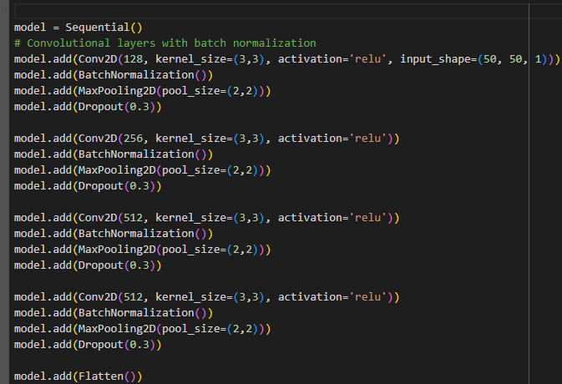
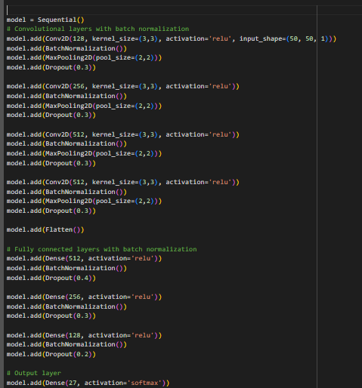
Model Details

Slide 9
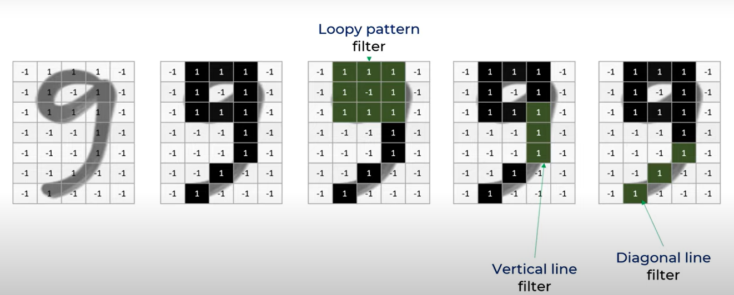
Model Details

Slide 10
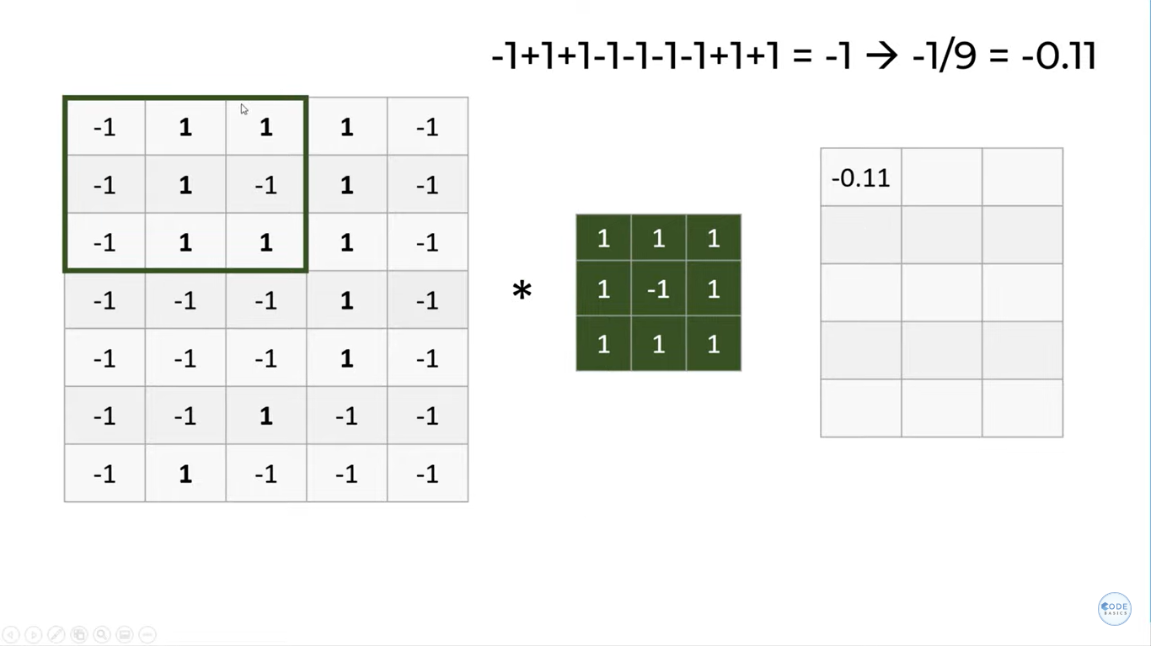
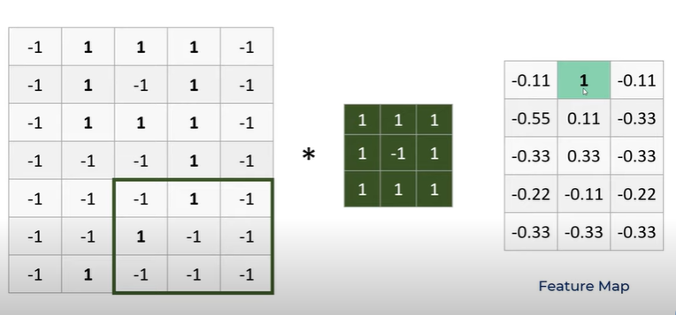
Model Details

Slide 11
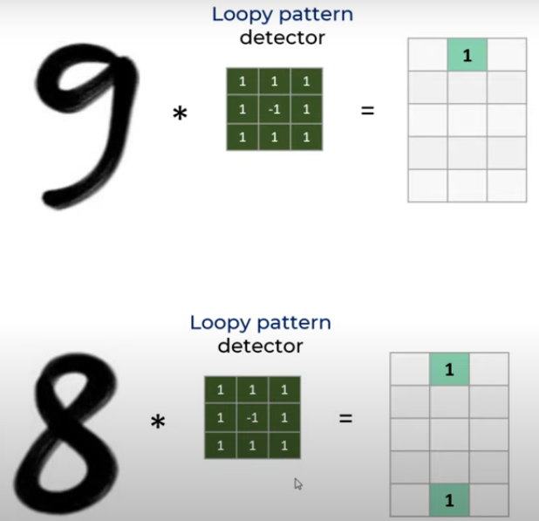
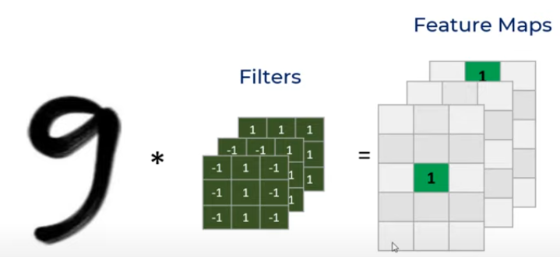
Model Details

Slide 12
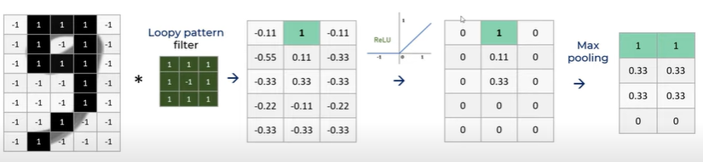
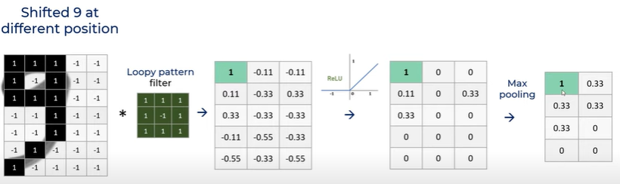
Model Details

Slide 13

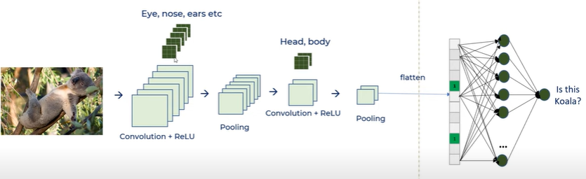
Model Details
Feature Extraction Classification

Slide 14
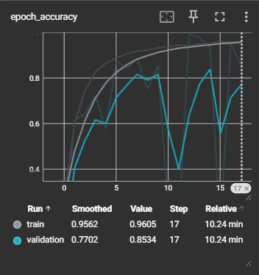
Results & Discussions
Model Performance: Training Accuracy: The CNN model achieved a high training accuracy, indicating that it was able to learn the patterns in the training data effectively. Validation Accuracy: The validation accuracy was slightly lower than the training accuracy, suggesting that the model generalized well to unseen data but still had room for improvement. Test Accuracy: The test set accuracy was consistent with the validation accuracy, reinforcing that the model’s performance was robust across different dataset.
Loss Metrics: Training Loss: The training loss decreased steadily over epochs, indicating that the model was learning and fitting the training data well. Validation Loss: The validation loss showed a similar trend to the training loss but started to plateau, suggesting that further training might not yield significant improvements without overfitting.

Slide 15
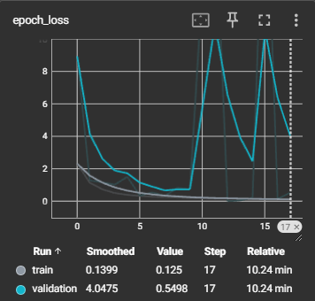
Results & Discussions
Discussion
1. Interpretation of Results
Model Performance: Interpretation of quantitative results and what they imply about the model's effectiveness.
Error Patterns: Discussion on the types of errors the model makes and potential reasons.
2. Comparison with Existing Methods
Benchmarking: How the model compares to existing sign language recognition systems.
Improvements: Specific improvements over previous approaches (e.g., better accuracy, faster inference).
3. Challenges and Limitations
Data Challenges: Issues related to dataset quality, diversity, and representativeness.
Model Limitations: Limitations of the model architecture or training process (e.g., overfitting, underfitting).

Slide 16
Challenges and learning
Throughout our project, we tackled challenges and gained valuable insights. From dataset creation to model deployment, each phase taught us collaboration, problem-solving, and technical skills.
We prioritized a well-structured dataset with consistent conditions for accurate model predictions. During training, we optimized performance through data preprocessing, augmentation, and hyper parameter tuning, addressing issues like overfitting and under fitting.
This experience deepened our understanding of AI's transformative potential in enhancing accessibility and inclusivity.

Slide 17




Tools and Technologies
Open cv
Tenserflow
Html /Css
Keras
Flask

Slide 18
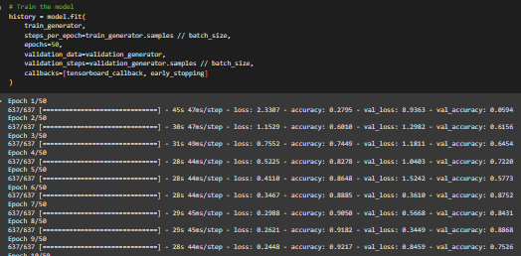
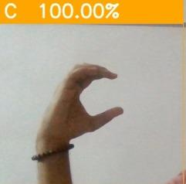
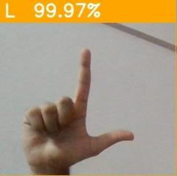
Project Demo
For giving demo, we have performed some sign language actions in front of camera. The given examples show letter ‘c’ and letter ‘L’.
The code shows the model being train and we can see how it is improving its accuracy in each epoch

Slide 19
Reference
Examples
Book reference
Michelucci , U. (no date) Advanced Applied Deep Learning: Convolutional Neural Networks and Object Detection. Available at: https://www.amazon.com/dp/1484249755?tag=uuid10-20 (Accessed: 29 September 2019).
Website reference
Mishra, M. (2020) Convolutional Neural Networks, explained, Medium. https://towardsdatascience.com/convolutional-neural-networks-explained-9cc5188c4939 (Accessed: 26 June 2024).
Garcia, B. and Viesca, S.A. (no date) Real-time American Sign Language Recognition with Convolutional Neural Networks. Available at: https://cs231n.stanford.edu/reports/2016/pdfs/214_Report.pdf (Accessed: 26 June 2024).
Journal reference
Alzubaidi, L. et al. (2021) Review of Deep Learning: Concepts, CNN Architectures, challenges, applications, future directions - Journal of Big Data, SpringerOpen. Available at: https://journalofbigdata.springeropen.com/articles/10.1186/s40537-021-00444-8 (Accessed: 26 June 2024).

Slide 20
Thank you!

